Slide 1
Unit V
Introduction to Cloud Computing

Slide 2
Introduction
Cloud Computing is the delivery of computing services such as servers, data storage, databases, networking, software, analytics, and intelligence over the internet (“cloud”) to offer flexible resources, faster innovation, and economies of scale.
Instead of owning data centers, organizations can rent access to someone else’s infrastructure like storage, computing servers, and databases from a cloud computing service provider and only pay for resources that they use.

Slide 3
Cloud Deployment Models
Public Cloud
Private Cloud
Hybrid Cloud
Community Cloud
Multi-Cloud

Slide 4
Cloud Deployment Models
Public Cloud
The public cloud is one in which cloud infrastructure services are provided over the internet to the general people or major industry groups. The infrastructure in this cloud model is owned by the entity that delivers the cloud services, not by the consumer. It is a type of cloud hosting that allows customers and users to easily access systems and services. This form of cloud computing is an excellent example of cloud hosting, in which service providers supply services to a variety of customers.

Slide 5
Cloud Deployment Models
Public Cloud Model Advantages
Minimal Investment
No setup cost
Infrastructure Management is not required
No maintenance
Dynamic Scalability
Public Cloud Model Disadvantages
Less secure
Low customization

Slide 6
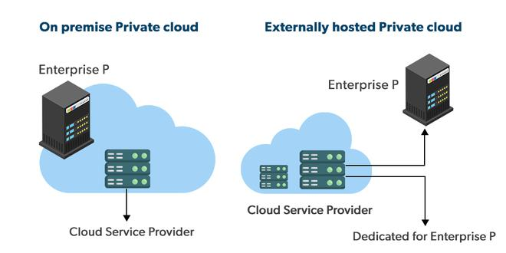
Cloud Deployment Models
Private Cloud
It’s a one-on-one environment for a single user (customer). There is no need to share your hardware with anyone else.

Slide 7
Cloud Deployment Models
Hybrid Cloud
By bridging the public and private worlds with a layer of proprietary software, hybrid cloud computing gives the best of both worlds.
Community Cloud
It allows systems and services to be accessible by a group of organizations. It is a distributed system that is created by integrating the services of different clouds to address the specific needs of a community, industry, or business. The infrastructure of the community could be shared between the organization which has shared concerns or tasks.

Slide 8
Cloud Computing Services
1. Infrastructure as a Service (IaaS in Cloud Computing)
The capability provided to the consumer is to provision processing, storage, networks, and other fundamental computing resources. The consumer does not manage or control the underlying cloud infrastructure but has control over operating systems, storage, and deployed applications; and possibly limited control of select networking components (e.g., host firewalls).

Slide 9
Cloud Computing Services
2. Platform as a Service (PaaS in Cloud Computing)
The capability provided to the consumer is to deploy onto the Cloud infrastructure consumer-created or acquired applications using programming languages, libraries, services, and tools supported by the provider. The consumer does not manage or control the underlying Cloud infrastructure including network, servers, operating systems, or storage, but has control over the deployed applications and possibly configuration settings for the application-hosting environment.

Slide 10
Cloud Computing Services
3. Software as a Service (SaaS in Cloud Computing)
The capability provided to the consumer is their applications running on a Cloud infrastructure. The capability provided to the consumer is to use the provider's applications running on a Cloud infrastructure. The applications are accessible from various client devices through either a thin client interface, such as a web browser (e.g., web-based e-mail), or a program interface.

Slide 11
Data Analytics
Businesses have long used data analytics to help direct their strategy to maximize profits. Ideally data analytics helps eliminate much of the guesswork involved in trying to understand clients, instead systemically tracking data patterns to best construct business tactics and operations to minimize uncertainty. Not only does analytics determine what might attract new customers, often analytics recognizes existing patterns in data to help better serve existing customers, which is typically more cost effective than establishing new business.

Slide 12
Data Analytics
In an ever-changing business world subject to countless variants, analytics gives companies the edge in recognizing changing climates so they can take initiate appropriate action to stay competitive. Alongside analytics, cloud computing is also helping make business more effective and the consolidation of both clouds and analytics could help businesses store, interpret, and process their big data to better meet their clients’ needs.

Slide 13
Data Analytics
Utility
Social Media
Tracking Products
Tracking Preference
Keeping Records

Slide 14
Virtualization
Virtualization is technology that you can use to create virtual representations of servers, storage, networks, and other physical machines. Virtual software mimics the functions of physical hardware to run multiple virtual machines simultaneously on a single physical machine. Businesses use virtualization to use their hardware resources efficiently and get greater returns from their investment. It also powers cloud computing services that help organizations manage infrastructure more efficiently.

Slide 15
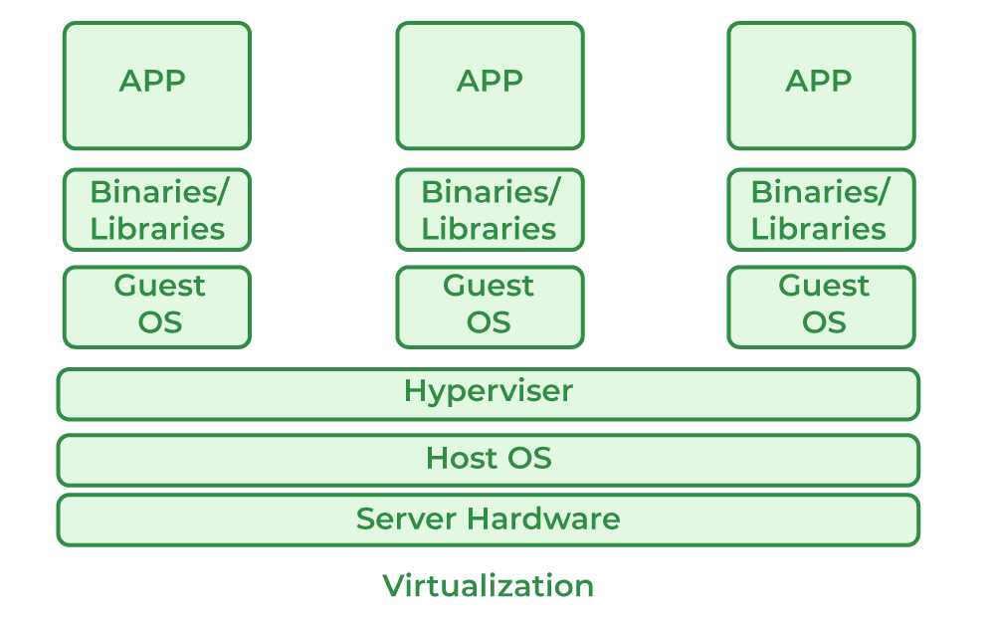

Slide 16
How Does Virtualization Work?
A hypervisor is a software that allows you to create a virtual layer over the hardware system that manages the interaction between the virtual machines and the system's hardware resources. They are installed as any other software application in the system and perform the task of virtualization. It acts as a connection between the physical system and virtual machines to ensure the proper access of the hardware resources. How this process takes place is mentioned later in this tutorial on what is virtualization.

Slide 17
How Does Virtualization Work?
It also manages so that the virtual machines don't interfere with each other's memory and computing resources. The hypervisor also manages the Virtual machines and is known as the virtual machine monitor (VMM).Utilizing such software and the method by using the reference from this tutorial on what is virtualization, you can effectively use our system's underlying hardware resources, i.e., not only applicable to computers but also to network, cloud, and data resources.

Slide 18
Hypervisor and their Types
Type1/Bare Metal: This type of hypervisor interacts directly with the hardware resources of the system, replacing the host operating system, i.e., it is also known as a bare-metal hypervisor.
Type2: This type of hypervisor runs as a software application on the host operating system, and it also coordinates with the virtual machines for hardware resource management.

Slide 19
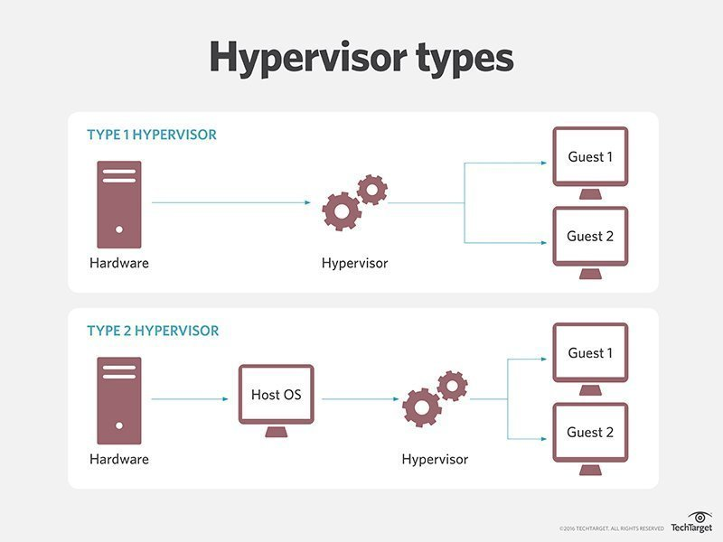
Hypervisor and their Types

Slide 20
Top 5 virtualization tools for Developers
Vagrant
Microsoft Hyper-V
RedHat Virtualization
VMware Workstation
VMware Fusion

Slide 21
Skill Set for Cloud Computing
Cloud Mitigation and Deployment
Database Proficiency
Serverless Architecture
System or Platform Certifications
Programming skills
DevOps

Slide 22
Job roles in Cloud Computing
Cloud Developer
Cloud Security Engineer
SysOps Administrator
Front-End and Back-End Developer
Development Operations Engineer
Solutions Architect

